Slide 1
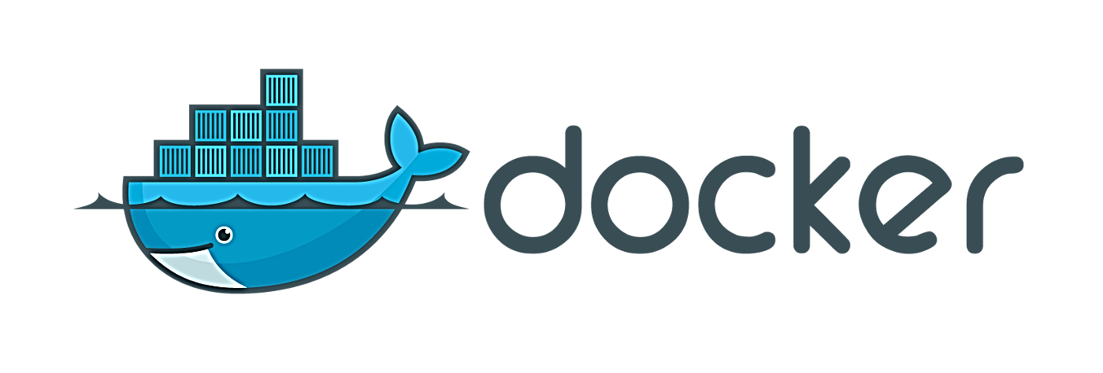
By
V PRADYOTAN RAJU

Slide 2

What is Docker? Why Docker?

Slide 3
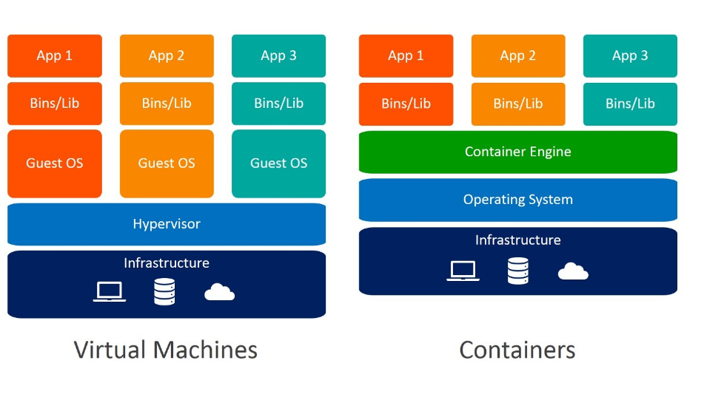
Containerization vs Virtualization

Slide 4
What is Docker?
Docker is a container management service. The keywords of Docker are develop, ship and run anywhere. The whole idea of Docker is for developers to easily develop applications, and ship them into containers which can then be deployed anywhere.
The initial release of Docker was in March 2013 and since then, it has become the buzzword for modern world development, especially in the face of Agile-based projects.

Slide 5
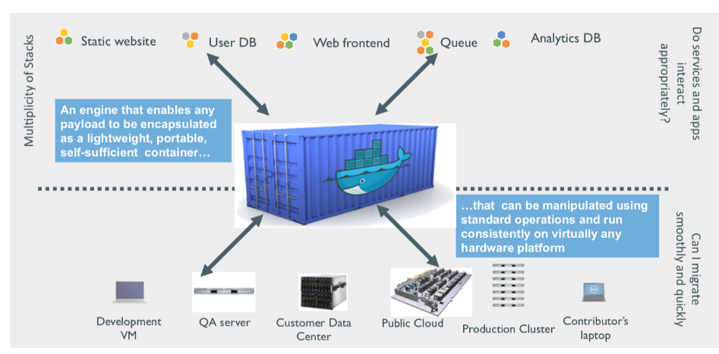
Why use Docker?
Using Docker can help you ship your code faster, and gives you control over your applications. You can deploy applications on containers that make it easier for them to be deployed, scaled, perform rollbacks and identify issues. It also helps in saving money by utilizing resources. Docker-based applications can be seamlessly moved from local development machines to production deployments. You can use Docker for Microservices, Data Processing, Continuous Integration and Delivery, and Containers as a Service.

Slide 6
Advantages of Docker
Isolation:
Portability:
Lightweight
Memory Usage
Performance
Security

Slide 7
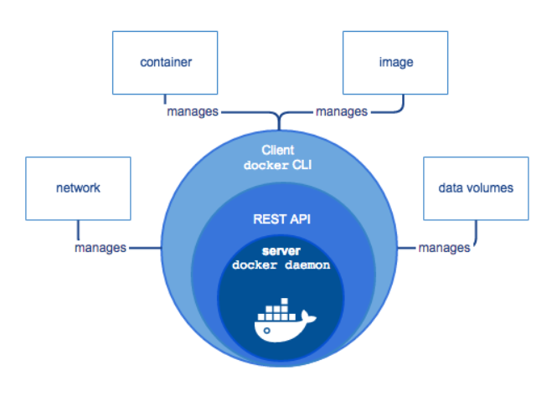
Docker Architecture

Slide 8
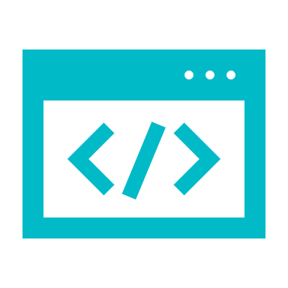
Docker client
This is what you use to interact with Docker. When you run a command using docker, the client sends the command to the daemon, which carries them out. The Docker client can communicate with more than one daemon.

Slide 9
Docker daemon
It listens to the API requests being made through the Docker client and manages Docker objects such as images, containers, networks, and volumes.

Slide 10
Docker file
Describes steps to create a Docker image. It’s like a recipe with all ingredients and steps necessary in making your dish. This file can be used to create Docker Image. These images can be pulled to create containers in any environment. These images can also be stored online at docker hubs. When you run a docker image you get docker containers. The container will have the application with all its dependencies.

Slide 11
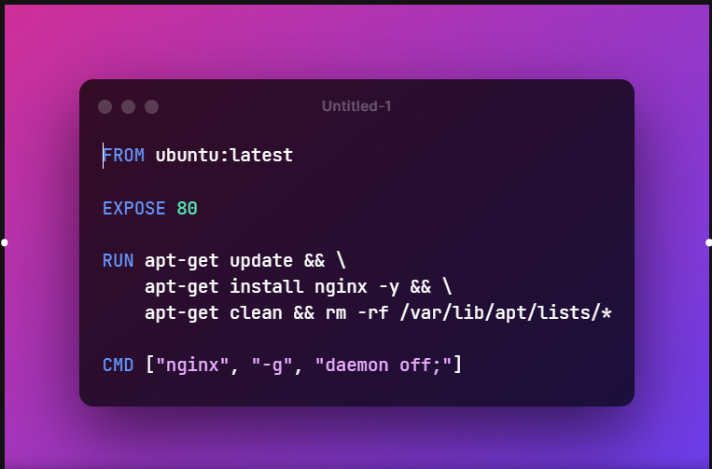
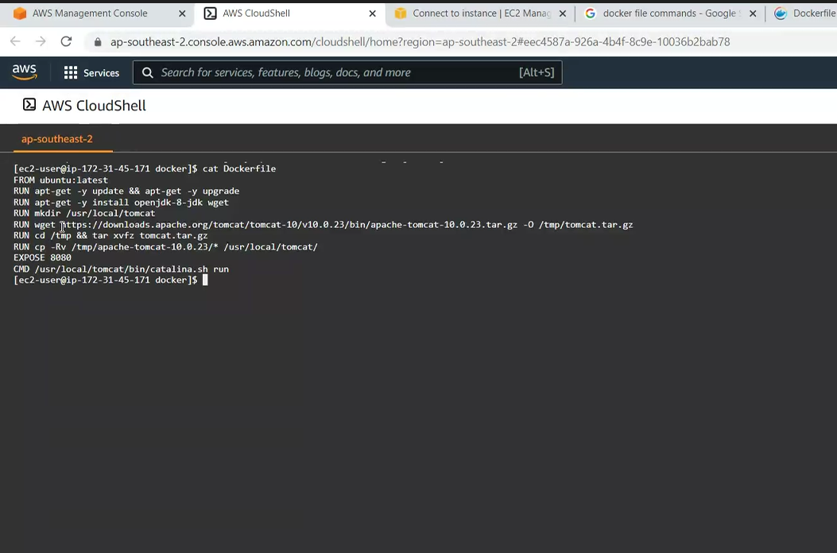
Docker File

Slide 12
Docker registries
This is where Docker images are stored. Docker Hub is a public registry that anyone can use. When you pull an image, Docker by default looks for it in the public registry and saves the image on your local system on DOCKER_HOST. You can also store images on your local machine or push them to the public registry.

Slide 13
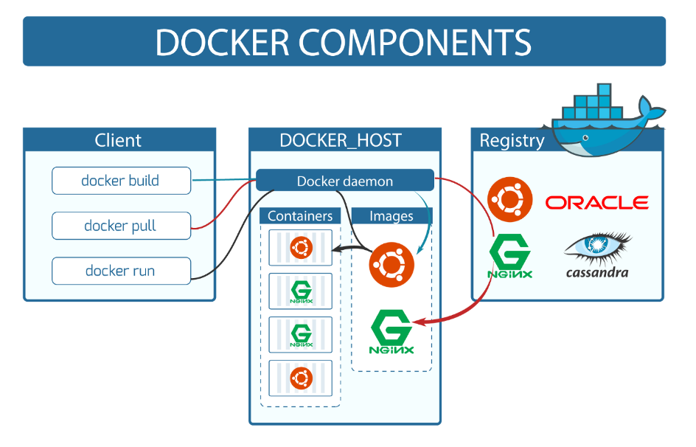
Docker Components

Slide 14
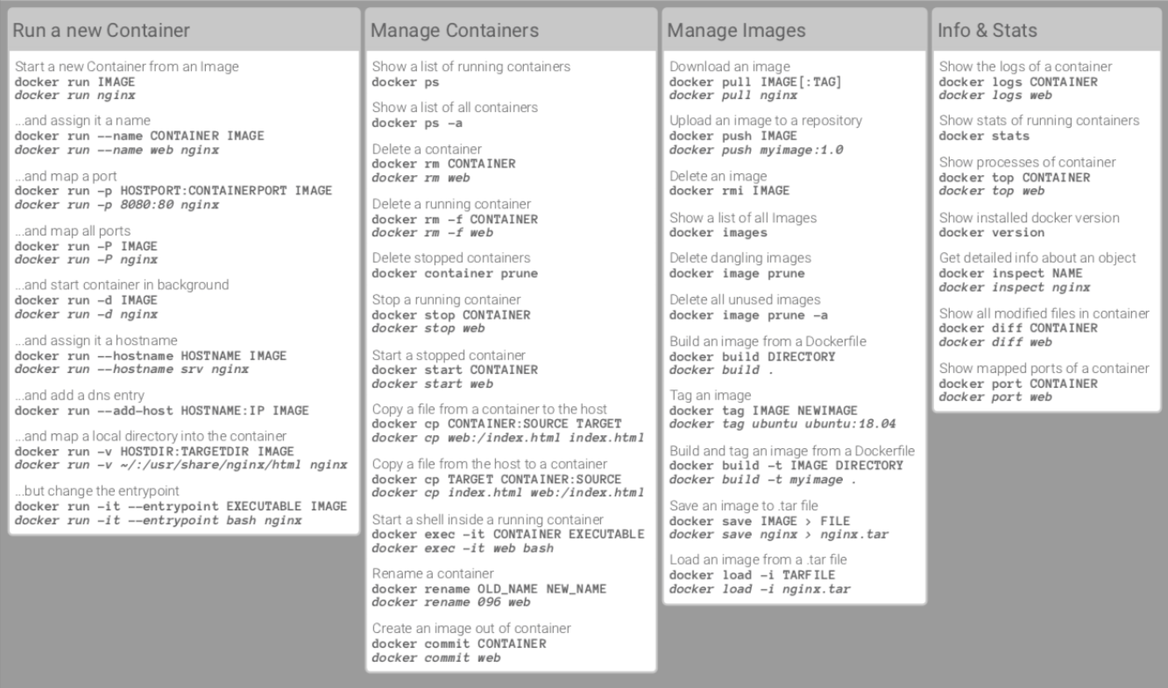
Cheat sheet for Docker CLI

Slide 15
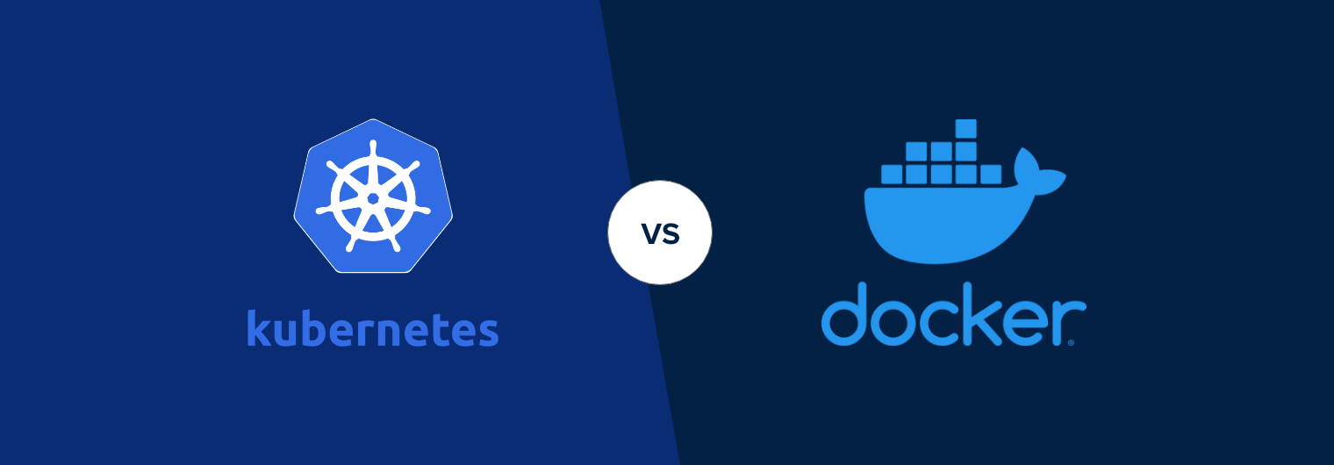
Docker is a suite of software development tools for creating, sharing and running individual containers; Kubernetes is a system for operating containerized applications at scale. Kubernetes (also known as k8s or “kube”)

Slide 16
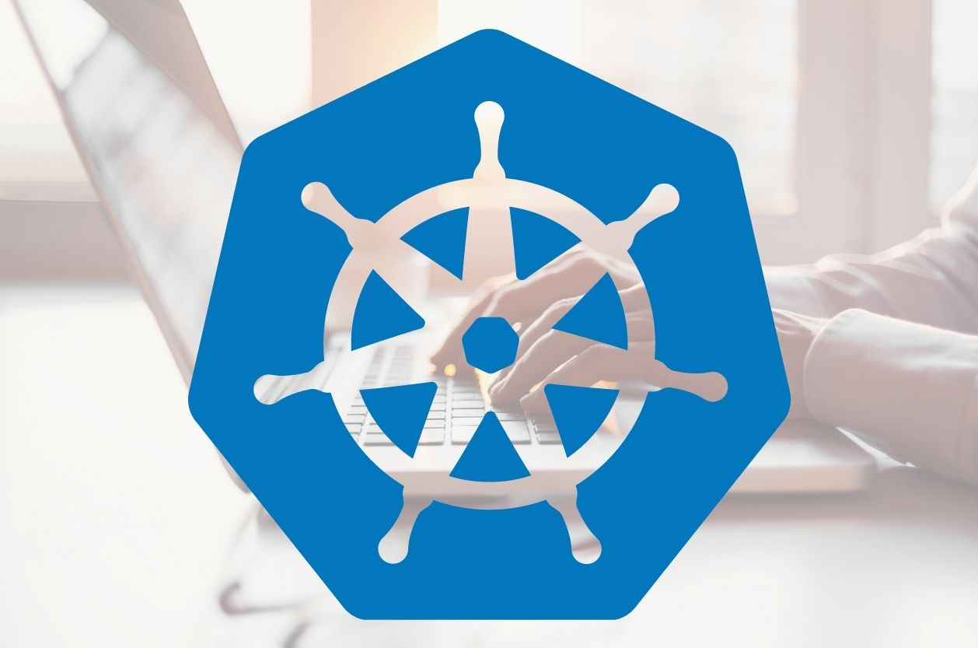
Why ????..K8’s..
Kubernetes Alternatives: Container as a Service (CaaS)
AWS Fargate. ...
Azure Container Instances. ...
Google Cloud Run. ...
Google Kubernetes Engine (GKE) ...
Amazon Elastic Kubernetes Service (EKS) ...
Openshift Container Platform. ...
Rancher. ...
Docker Swarm.

Slide 17
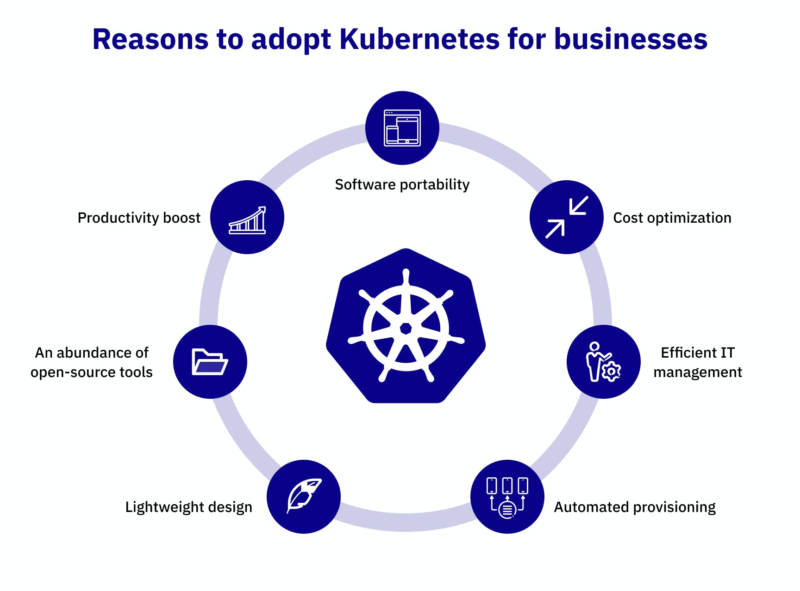

Slide 18

Thank You

